Slide 1

Product Backlog Release 1(MVP)
ID | Story | Estimation | Priority
1.1 | As a user, I want to find out the goods by selecting in key words so that I can find the goods I need. |  | 1
1.9 | As an unregistered user, I want to search for the corresponding product by keyword. |  | 2
1.10 | As a merchant, I want to manage my products, including listing and delete them, as well as categorizing them, so that I can maintain an organized and updated inventory. |  | 3
1.2 | As a user, I want to add the goods in shopping cart so that I can pay uniformly. |  | 4
1.7 | As an unregistered user, I want to be able to click through to see the details of the product, such as price, style, etc. |  | 5
1.3 | As a user, I want to checkout cart so that I can pay for my goods. |  | 6
1.4 | As a user, I want to track my order’s status so that I can know when I can get my goods. |  | 7
1.11 | As a merchant, I want to manage orders, specifically the ability to view order statuses, so that I can keep track of the progress and status of each transaction. |  | 8
1.12 | As a merchant, I want to integrate logistics information, so that I can seamlessly connect with logistics companies and achieve real-time updates and queries of order shipping information, ensuring smooth delivery to my customers. |  | 9

Slide 2
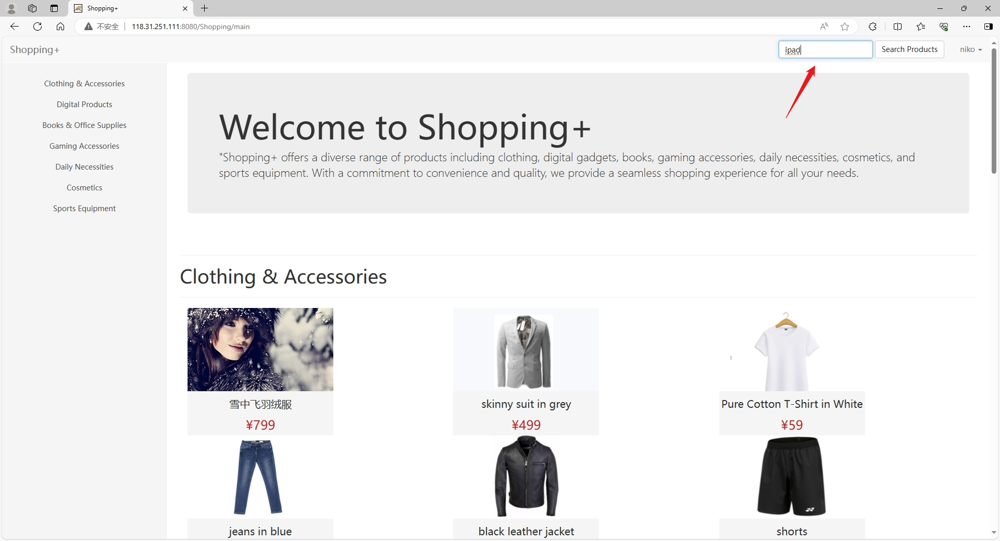
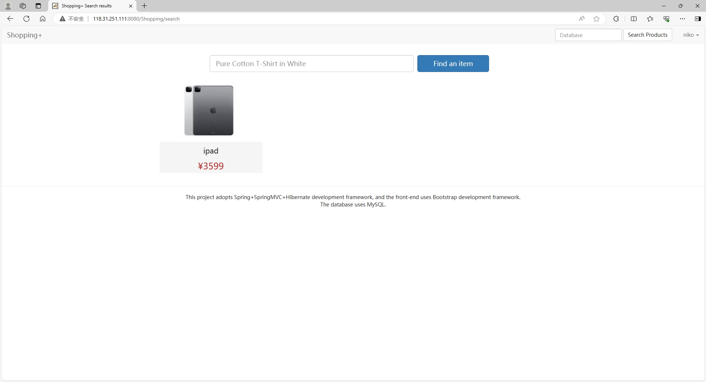

Slide 3
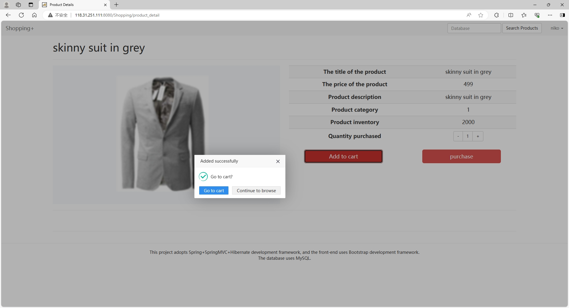
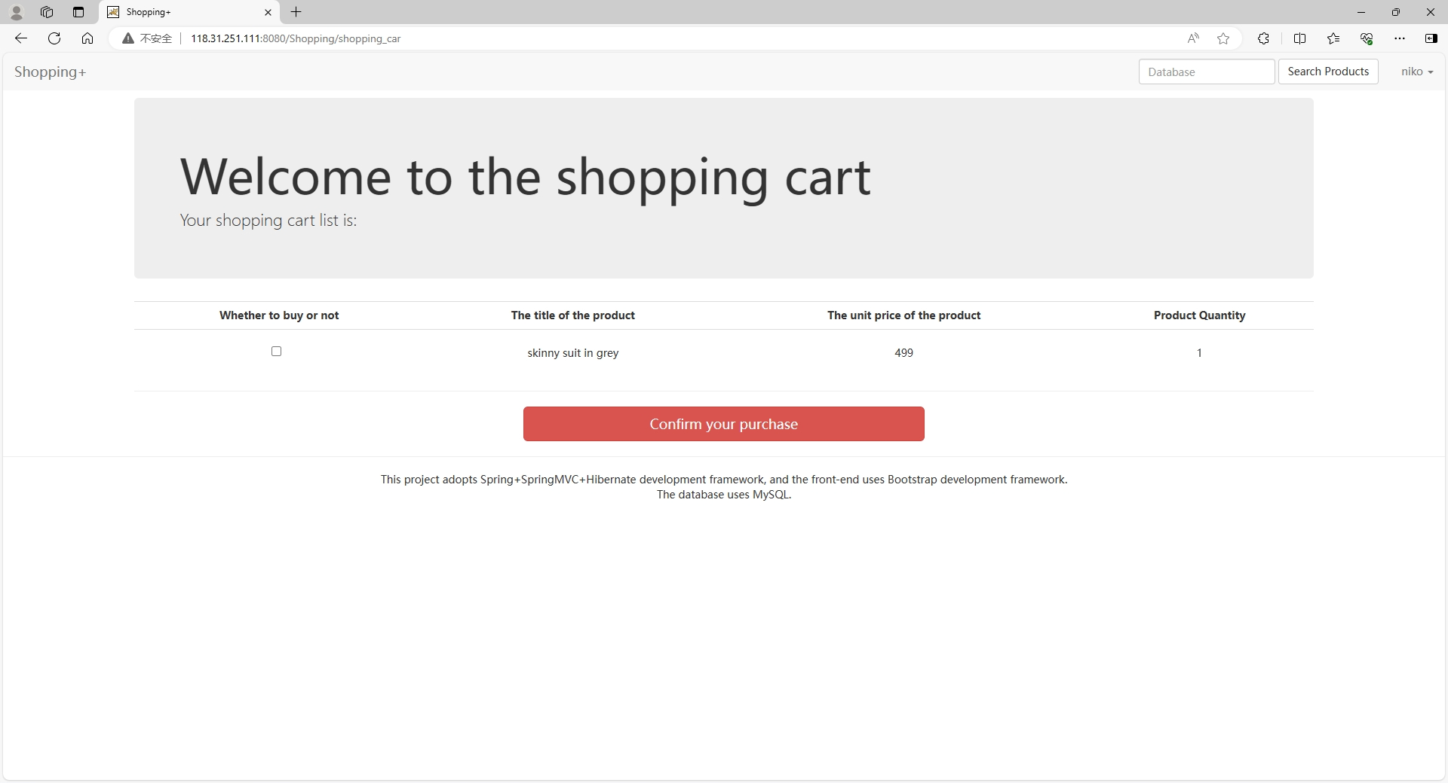

Slide 4
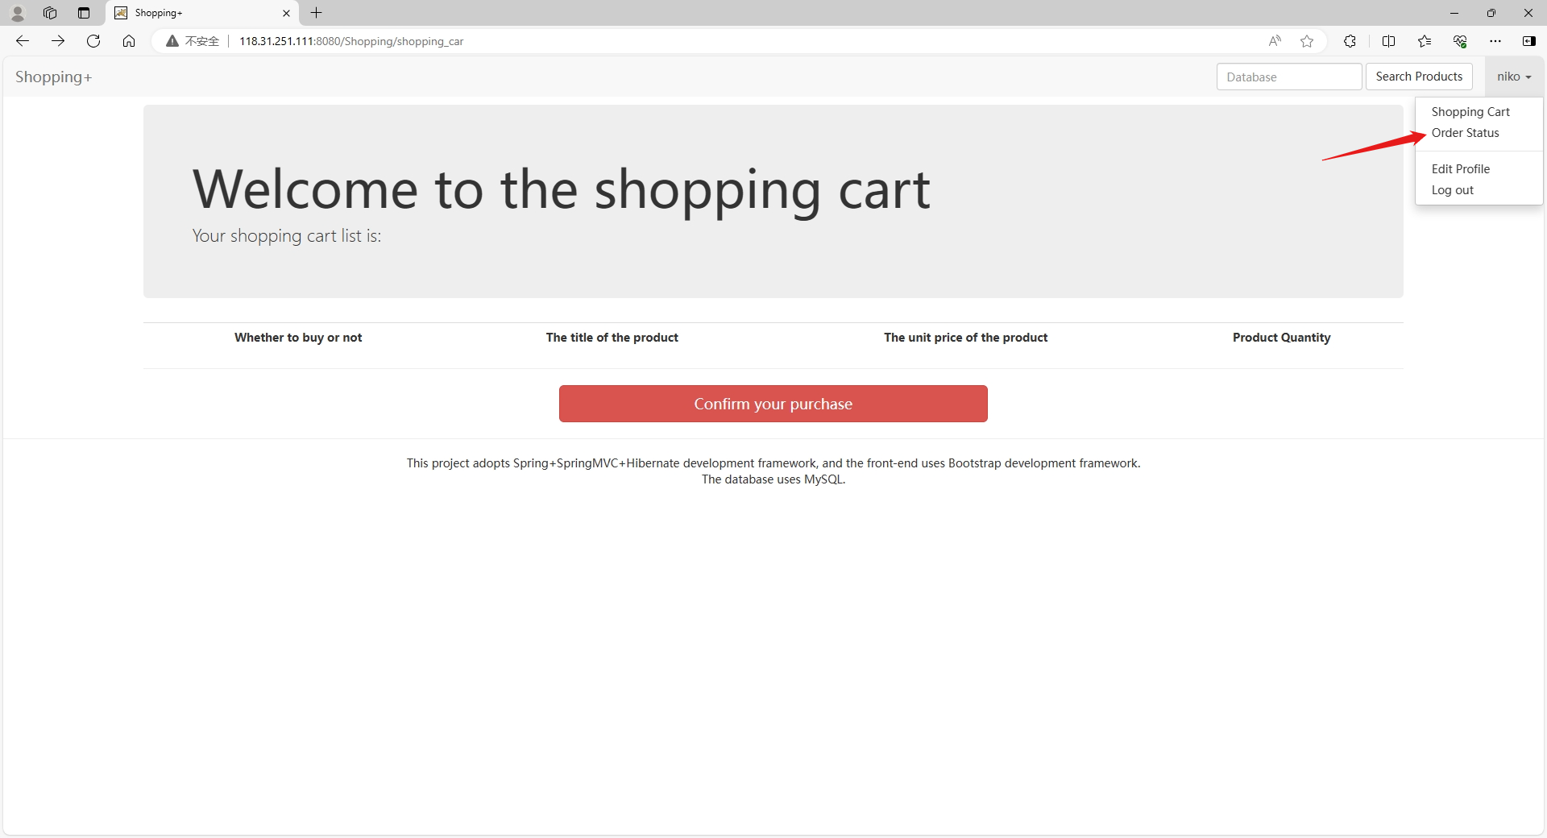
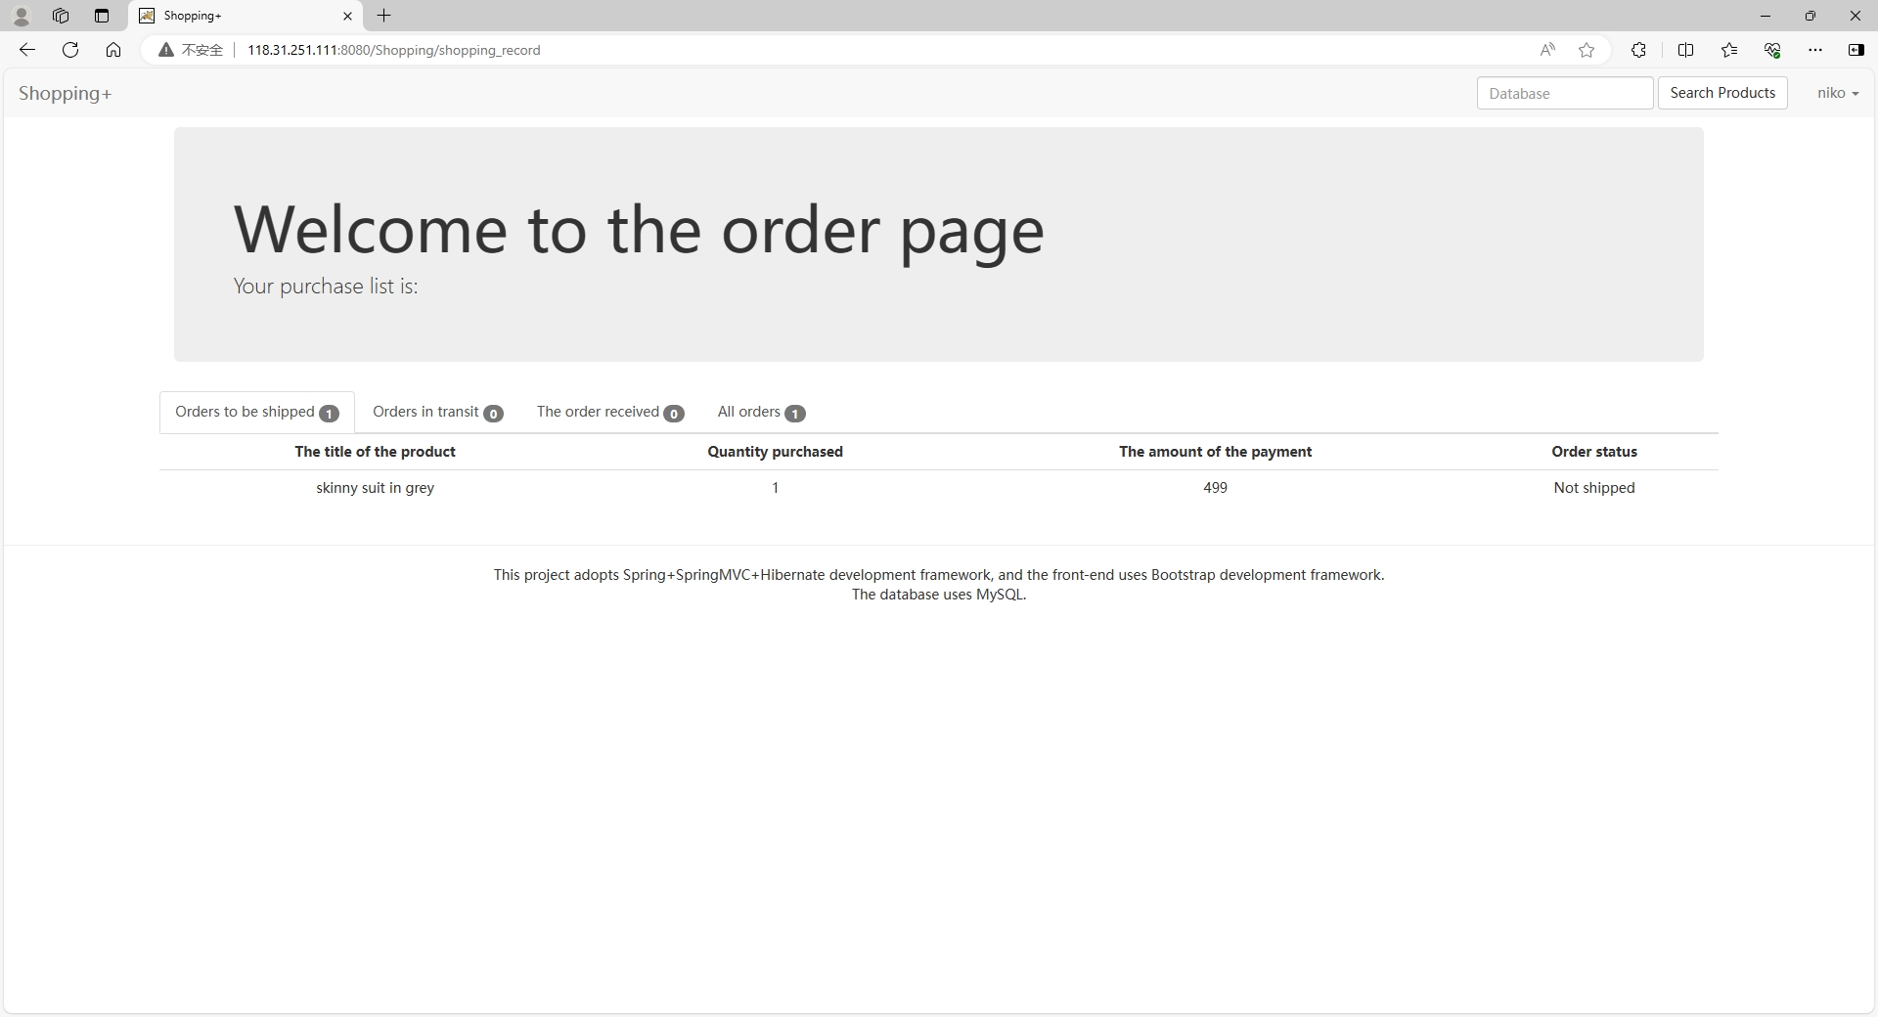

Slide 5
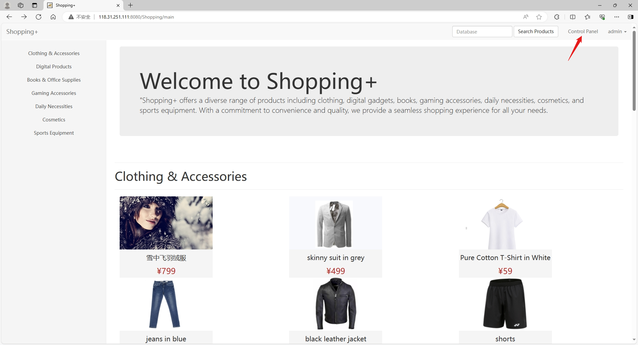
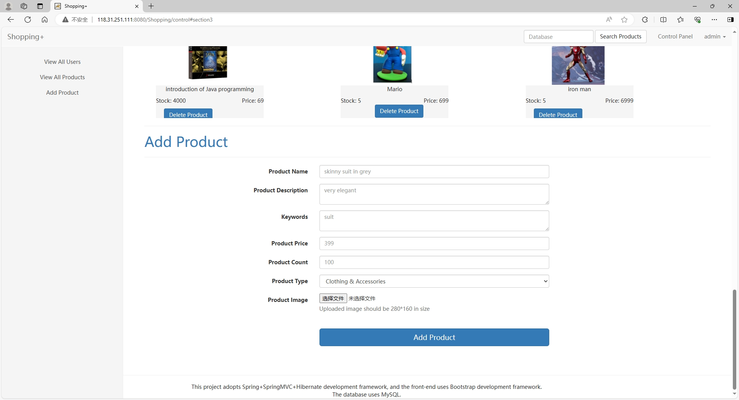
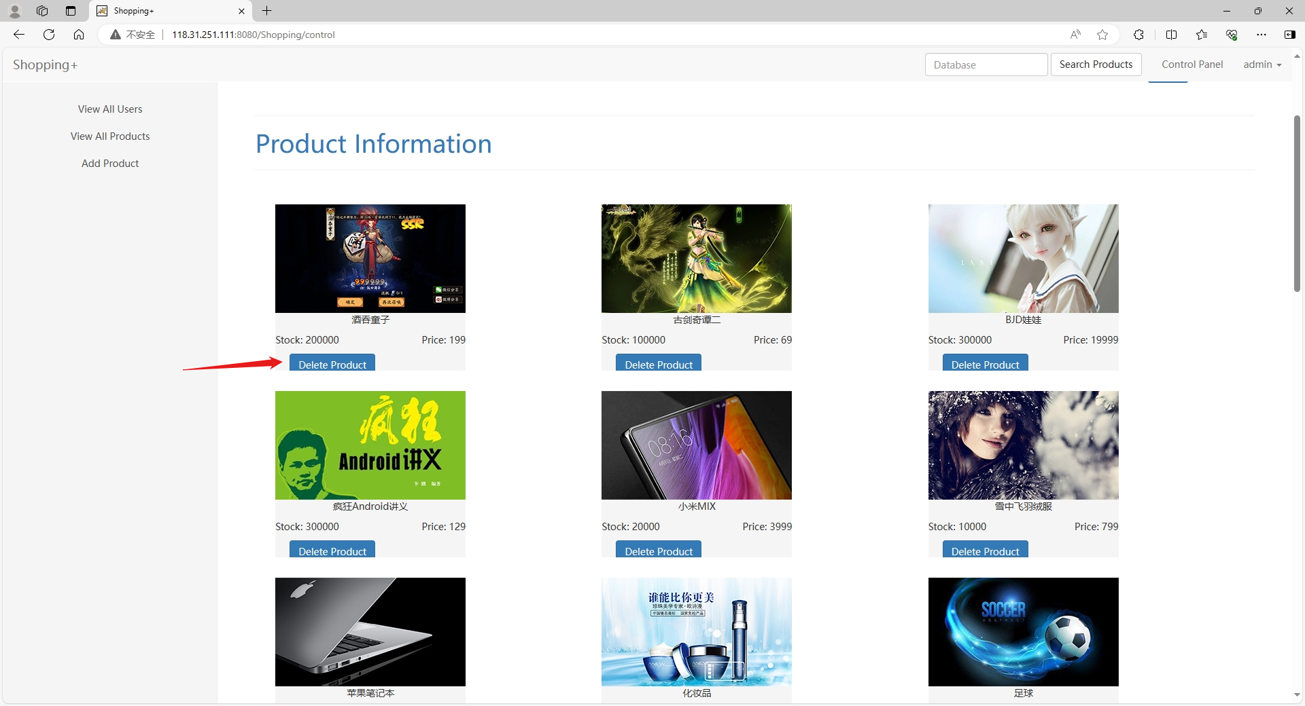

Slide 6

